Slide 1
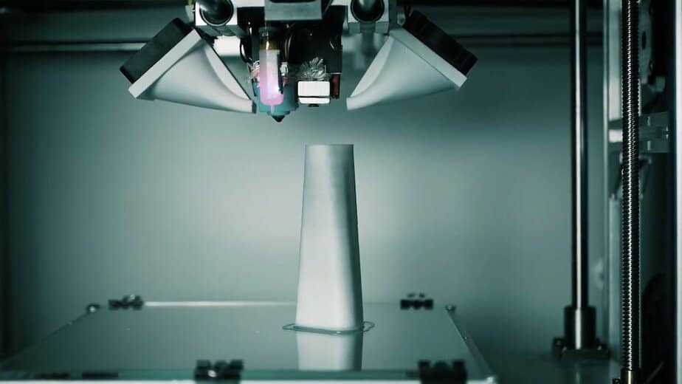



Prepared by Shyamala Venkatakrishnan, Heejae Roh
Nikshita Ranganathan, Archit Barua
Professor Venkata Duvvuri
May 25th, 2023
Notes:
Source(northeastern mark): https://brand.northeastern.edu/visual-identity/university-wordmarks/
Source(3DHEALS logo): https://logovectordl.com/3dheals-llc-logo-vector-svg/
Source: https://3dheals.com/interview-with-denys-gurak-a-d-a-m-and-3d-printed-bones/
Color: https://3dheals.com/

Slide 2

Company Details
01
04
Predictive Model
A brief introduction to 3DHeals
Building customer email lookalike
SWOT & Plan
02
05
Next Steps
Assessing four aspects of business
Plans for the future
EDA
03
06
Q&A
Summary of data insights
Notes:
Source(3DHEALS logo): https://logovectordl.com/3dheals-llc-logo-vector-svg/
Source(background): https://www.fastradius.com/resources/video-lattice-design-and-foam-replacement-in-3d-printing/
Color: https://3dheals.com/

Slide 3
Company
Details
01
Notes:
Source(3DHEALS logo): https://logovectordl.com/3dheals-llc-logo-vector-svg/
Source(background): https://www.fastradius.com/resources/video-lattice-design-and-foam-replacement-in-3d-printing/
Color: https://3dheals.com/

Slide 4
Company Details – 3DHeals
Industry: Healthcare Technology
Headquarters: San Francisco, California
Founded Year: 2015
Founder: Jenny Chen, MD
Website: https://3dheals.com
Mission: Promoting collaboration, knowledge exchange, and adoption of 3D printing in healthcare.
Services: Events, online education, consulting, community building, startup support, research &
development
Notes:
Source(3DHEALS logo): https://logovectordl.com/3dheals-llc-logo-vector-svg/
Source(background): https://www.fastradius.com/resources/video-lattice-design-and-foam-replacement-in-3d-printing/
Color: https://3dheals.com/

Slide 5
Company Details – 3DHeals
Accomplishments:
2016 Frost & Sullivan Award for Technology Innovation in Medical Devices
2017 Fast Company World Changing Ideas Award
2018 Forbes Next Billion-Dollar Startups
Challenges:
High 3D printing costs
Limited regulatory approval for medical devices
Healthcare provider education needed
Competitors: Stratasys, 3D Systems, and Organovo
Notes:
Source(3DHEALS logo): https://logovectordl.com/3dheals-llc-logo-vector-svg/
Source(background): https://www.fastradius.com/resources/video-lattice-design-and-foam-replacement-in-3d-printing/
Color: https://3dheals.com/

Slide 6
SWOT
Analysis
02
Strengths, Weaknesses, Opportunities and Threats
Notes:
Source(3DHEALS logo): https://logovectordl.com/3dheals-llc-logo-vector-svg/
Source(background): https://www.fastradius.com/resources/video-lattice-design-and-foam-replacement-in-3d-printing/
Color: https://3dheals.com/

Slide 7
SWOT Analysis of 3DHEALS
3DHEALS is a company operating in the healthcare industry, focusing on the integration of 3D printing and bioprinting technologies to create innovative and personalized medical solutions. To evaluate the current position of the company and identify opportunities and challenges, a SWOT analysis is conducted. This analysis covers the company's strengths, weaknesses, opportunities, and threats in the context of the industry.
Notes:
Source(3DHEALS logo): https://logovectordl.com/3dheals-llc-logo-vector-svg/
Source(background): https://www.fastradius.com/resources/video-lattice-design-and-foam-replacement-in-3d-printing/
Color: https://3dheals.com/

Slide 8
Introduction
Domain expertise: 3DHEALS has specialized knowledge in the field of 3D printing and bioprinting, which sets them apart from competitors and helps them deliver cutting-edge healthcare solutions.
Innovation and technology adoption: The company is committed to staying at the forefront of technological advancements, such as artificial intelligence, to improve the efficiency and effectiveness of their products and services.
Customization and personalization: 3DHEALS offers personalized solutions tailored to individual patients, which can improve patient outcomes and satisfaction.
Strong network and partnerships: The company has built relationships with various stakeholders in the healthcare industry, such as hospitals, research institutions, and medical device manufacturers, which can facilitate collaboration and business growth.
Notes:
Source(3DHEALS logo): https://logovectordl.com/3dheals-llc-logo-vector-svg/
Source(background): https://www.fastradius.com/resources/video-lattice-design-and-foam-replacement-in-3d-printing/
Color: https://3dheals.com/

Slide 9
Strengths
Domain expertise: 3DHEALS has specialized knowledge in the field of 3D printing and bioprinting, which sets them apart from competitors and helps them deliver cutting-edge healthcare solutions.
Innovation and technology adoption: The company is committed to staying at the forefront of technological advancements, such as artificial intelligence, to improve the efficiency and effectiveness of their products and services.
Customization and personalization: 3DHEALS offers personalized solutions tailored to individual patients, which can improve patient outcomes and satisfaction.
Strong network and partnerships: The company has built relationships with various stakeholders in the healthcare industry, such as hospitals, research institutions, and medical device manufacturers, which can facilitate collaboration and business growth.
Notes:
Source(3DHEALS logo): https://logovectordl.com/3dheals-llc-logo-vector-svg/
Source(background): https://www.fastradius.com/resources/video-lattice-design-and-foam-replacement-in-3d-printing/
Color: https://3dheals.com/

Slide 10
Weaknesses
Limited market awareness: As a niche player in the healthcare industry, 3DHEALS may face challenges in increasing their visibility and attracting a broader customer base.
High production costs: 3D printing and bioprinting technologies can be expensive, which could limit the affordability of the company's products for certain markets or customer segments.
Dependence on skilled workforce: The company relies on a highly skilled workforce with expertise in multiple disciplines, making it difficult to scale operations rapidly.
Notes:
Source(3DHEALS logo): https://logovectordl.com/3dheals-llc-logo-vector-svg/
Source(background): https://www.fastradius.com/resources/video-lattice-design-and-foam-replacement-in-3d-printing/
Color: https://3dheals.com/

Slide 11
Opportunities
Growing demand for personalized medicine: The global trend towards personalized medicine offers a significant opportunity for 3DHEALS to expand its market share by providing tailored healthcare solutions.
Advancements in AI and data analysis: Leveraging AI and data analysis in the 3D printing process can improve efficiency, accuracy, and patient outcomes, positioning 3DHEALS as a leader in the field.
Collaboration with healthcare providers: Developing strategic partnerships with healthcare providers can help 3DHEALS access new markets and increase sales.
Research and development: Investing in R&D can lead to the development of new products, services, and technologies that drive growth and competitiveness.
Notes:
Source(3DHEALS logo): https://logovectordl.com/3dheals-llc-logo-vector-svg/
Source(background): https://www.fastradius.com/resources/video-lattice-design-and-foam-replacement-in-3d-printing/
Color: https://3dheals.com/

Slide 12
Threats
Competition: The healthcare industry is highly competitive, and 3DHEALS may face challenges from other companies offering similar products and services.
Regulatory challenges: The medical device industry is subject to strict regulations, which can impact the speed and cost of bringing new products to market.
Technological disruption: Rapid advancements in technology can lead to the development of new solutions that outpace current 3D printing capabilities, potentially affecting the company's competitiveness.
Intellectual property protection: Ensuring the protection of proprietary technologies, designs, and processes can be challenging in the fast-paced and innovative healthcare industry.
Notes:
Source(3DHEALS logo): https://logovectordl.com/3dheals-llc-logo-vector-svg/
Source(background): https://www.fastradius.com/resources/video-lattice-design-and-foam-replacement-in-3d-printing/
Color: https://3dheals.com/

Slide 13
EDA
Summary
03
Exploratory Data Analysis
Notes:
Source(3DHEALS logo): https://logovectordl.com/3dheals-llc-logo-vector-svg/
Source(background): https://www.fastradius.com/resources/video-lattice-design-and-foam-replacement-in-3d-printing/
Color: https://3dheals.com/

Slide 14
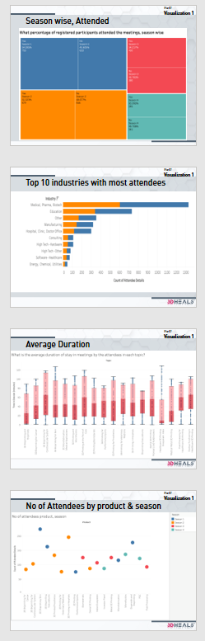
Summary of EDA 1
Over the course of four seasons, there was a gradual decrease in both the number of registrations and attendees for the meetings, with Season 1 having 1388 and Season 4 having 686 registrations.
Almost half of the registered members have not attended the meetings across all seasons.
The medical industry had the highest number of attendees at the meetings, followed by the education and manufacturing industries.
The topic '3D Bioprinting for Cardiovascular System' had the highest average duration of stay among attendees at 65 minutes. In contrast, the topic 'Healthcare 3D Printing Ecosystem: India' had the least average duration of stay among attendees at 7 minutes.
The meeting about the product '3D Bioprinting Skin', held during Season 1, had the maximum number of attendees at 250.
Notes:
Source(3DHEALS logo): https://logovectordl.com/3dheals-llc-logo-vector-svg/
Source(background): https://www.fastradius.com/resources/video-lattice-design-and-foam-replacement-in-3d-printing/
Color: https://3dheals.com/

Slide 15
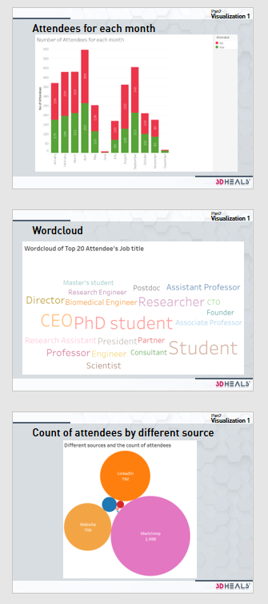
Summary of EDA 2
April had the highest number of attendees who answered "No" (283) and "Yes" (263), followed by September and March. The lowest attendance rates were in June and December. This may be due to a variety of factors like holidays, weather conditions, and marketing efforts.
The meeting had a diverse range of attendees, including many students and professionals such as CEOs, Directors, professors, and researchers. Students likely attended to gain knowledge and networking opportunities in the 3D printing and healthcare industries.
The attendees of the meeting learned about the 3DHeals event from a variety of sources, with the highest number coming from Mailchimp, followed by LinkedIn and other websites.
Notes:
Source(3DHEALS logo): https://logovectordl.com/3dheals-llc-logo-vector-svg/
Source(background): https://www.fastradius.com/resources/video-lattice-design-and-foam-replacement-in-3d-printing/
Color: https://3dheals.com/

Slide 16
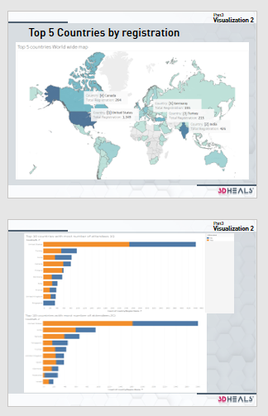
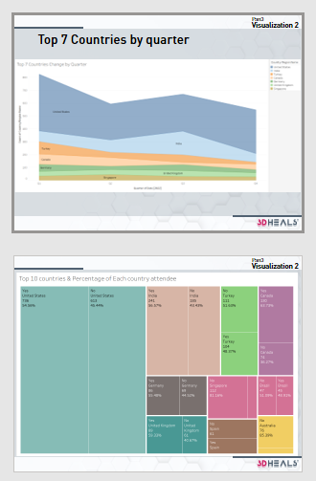
Summary of EDA 3
The top 5 registration by country was the United States with 1,349, followed by India with 426, followed by Turkey, Canada and Germany.
Checking the top 10 countries by each quarter, except top 5 countries in world wide, there are mainly European countries such as the UK and Spain. There are also Singapore, Australia, Israel and Brazil.
Top 7 countries by the number of registrations in each country by quarter fluctuated rather than constant.
In attendance rate by country, most of them were almost 50% attending and 50% not attending. Among the top 10 countries, Singapore shows 81%, Australia shows 85% not attended. On the other hand, Canada has the highest attendance rate at 63%, followed by the UK and Germany with 59% and 55%.
By proportions of the total attendees, the United States accounted for a quarter, followed by India with 8%, Turkey with 3.5% and Canada with 4.5%. Overall registrations were higher in Turkey, but due to attendance rates, the number of attendees in Canada was higher.
Notes:
Source(3DHEALS logo): https://logovectordl.com/3dheals-llc-logo-vector-svg/
Source(background): https://www.fastradius.com/resources/video-lattice-design-and-foam-replacement-in-3d-printing/
Color: https://3dheals.com/

Slide 17
Predictive
Model
04
Building customer Email Lookalike for targeting
Notes:
Source(3DHEALS logo): https://logovectordl.com/3dheals-llc-logo-vector-svg/
Source(background): https://www.fastradius.com/resources/video-lattice-design-and-foam-replacement-in-3d-printing/
Color: https://3dheals.com/

Slide 18
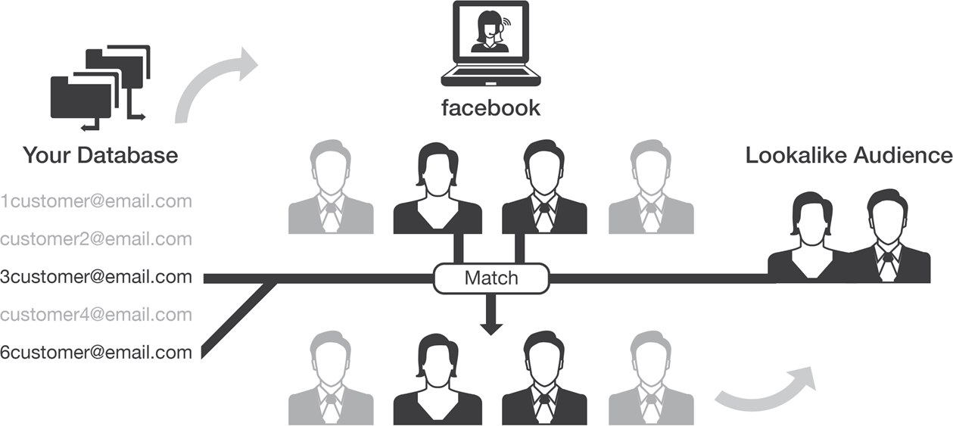
Model Target:
Building customer email lookalike
Features
Notes:
Source(3DHEALS logo): https://logovectordl.com/3dheals-llc-logo-vector-svg/
Source(background): https://www.fastradius.com/resources/video-lattice-design-and-foam-replacement-in-3d-printing/
Color: https://3dheals.com/
Source: https://www.lxahub.com/stories/core-concepts-of-predictive-marketing-using-look-alike-targeting

Slide 19
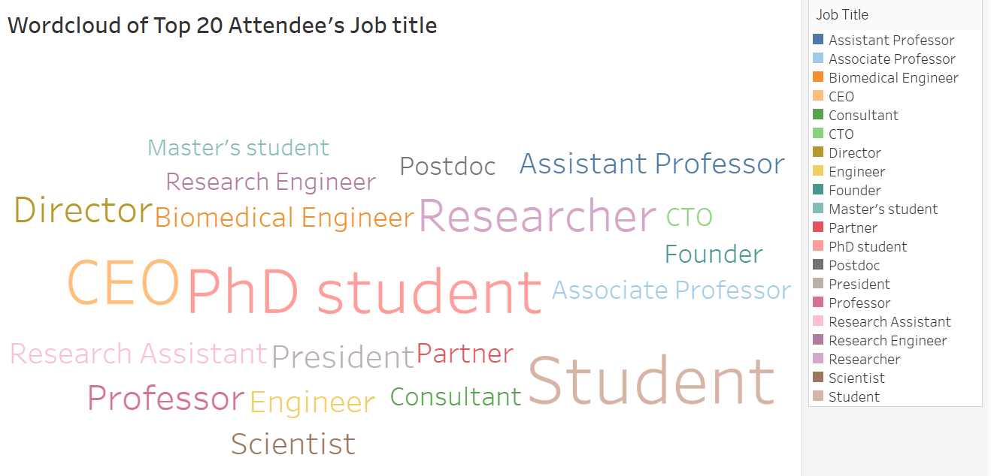
K-Mode Clustering
What if the data is
Categorical
Job Title
Country
Industry
Organization
Source Name
Domain
Notes:
Source(3DHEALS logo): https://logovectordl.com/3dheals-llc-logo-vector-svg/
Source(background): https://www.fastradius.com/resources/video-lattice-design-and-foam-replacement-in-3d-printing/
Color: https://3dheals.com/

Slide 20
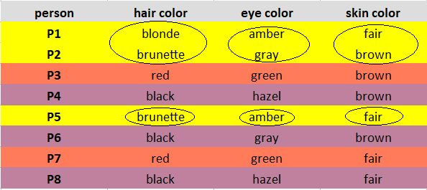
K-Mode Clustering
Select Modes instead of average
Notes:
Source(3DHEALS logo): https://logovectordl.com/3dheals-llc-logo-vector-svg/
Source(background): https://www.fastradius.com/resources/video-lattice-design-and-foam-replacement-in-3d-printing/
Color: https://3dheals.com/
Source: https://www.analyticsvidhya.com/blog/2021/06/kmodes-clustering-algorithm-for-categorical-data/

Slide 21

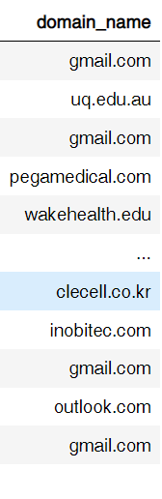


Data Cleaning
Removing unwanted variables
Extracting Domain Name
Removed: 'User Name (Original Name)','First Name','Last Name','Is Guest’, …
From email
01
02
03
Removing empty/missing records
Notes:
Source(3DHEALS logo): https://logovectordl.com/3dheals-llc-logo-vector-svg/
Source(background): https://www.fastradius.com/resources/video-lattice-design-and-foam-replacement-in-3d-printing/
Color: https://3dheals.com/
Source: https://www.analyticsvidhya.com/blog/2021/06/kmodes-clustering-algorithm-for-categorical-data/

Slide 22
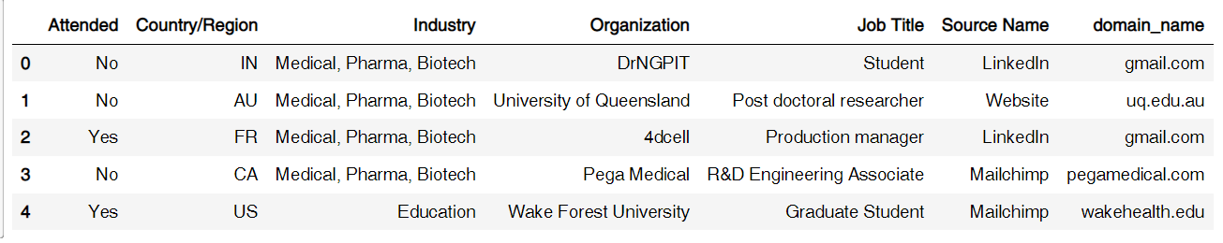
After Data Cleaning
6 Variables
3,078 Observations
Notes:
Source(3DHEALS logo): https://logovectordl.com/3dheals-llc-logo-vector-svg/
Source(background): https://www.fastradius.com/resources/video-lattice-design-and-foam-replacement-in-3d-printing/
Color: https://3dheals.com/
Source: https://www.analyticsvidhya.com/blog/2021/06/kmodes-clustering-algorithm-for-categorical-data/

Slide 23
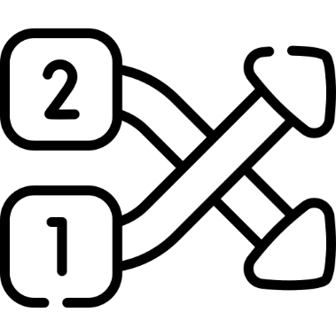
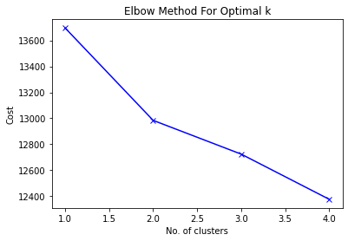
Finding optimal k with elbow method
Select Cluster variables
Decide n_Cluster = 2
Column | Unique
Country | 87
Industry | 30
Organization | 1,876
Job Title | 1,291
Source Name | 9
Domain | 745
01
02
03
Elbow curve
Finding optimal ‘K’
Notes:
Source(3DHEALS logo): https://logovectordl.com/3dheals-llc-logo-vector-svg/
Source(background): https://www.fastradius.com/resources/video-lattice-design-and-foam-replacement-in-3d-printing/
Color: https://3dheals.com/
Source: https://www.analyticsvidhya.com/blog/2021/06/kmodes-clustering-algorithm-for-categorical-data/

Slide 24
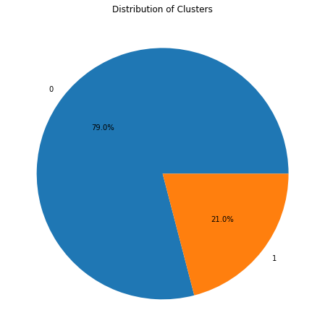
Cluster Ratio
Cluster | Counts | Percent
0 | 2,505 | 79.0%
1 | 573 | 21.0%
Notes:
Source(3DHEALS logo): https://logovectordl.com/3dheals-llc-logo-vector-svg/
Source(background): https://www.fastradius.com/resources/video-lattice-design-and-foam-replacement-in-3d-printing/
Color: https://3dheals.com/
Source: https://www.analyticsvidhya.com/blog/2021/06/kmodes-clustering-algorithm-for-categorical-data/

Slide 25
Cluster ‘0’ and Centroids
US
Medical, Pharma, Biotech
VoxCell BioInnovation
United States
Country/Region
Industry
Organization
CEO
Mailchimp
Gmail.com
Job Title
Source Name
Domain_name
Notes:
Source(3DHEALS logo): https://logovectordl.com/3dheals-llc-logo-vector-svg/
Source(background): https://www.fastradius.com/resources/video-lattice-design-and-foam-replacement-in-3d-printing/
Color: https://3dheals.com/
Source: https://www.analyticsvidhya.com/blog/2021/06/kmodes-clustering-algorithm-for-categorical-data/

Slide 26
Cluster ‘1’ and Centroids
IN
Education
The Hong Kong Polytechnic University
India
Country/Region
Industry
Organization
Student
Mailchimp
Gmail.com
Job Title
Source Name
Domain_name
Notes:
Source(3DHEALS logo): https://logovectordl.com/3dheals-llc-logo-vector-svg/
Source(background): https://www.fastradius.com/resources/video-lattice-design-and-foam-replacement-in-3d-printing/
Color: https://3dheals.com/
Source: https://www.analyticsvidhya.com/blog/2021/06/kmodes-clustering-algorithm-for-categorical-data/

Slide 27
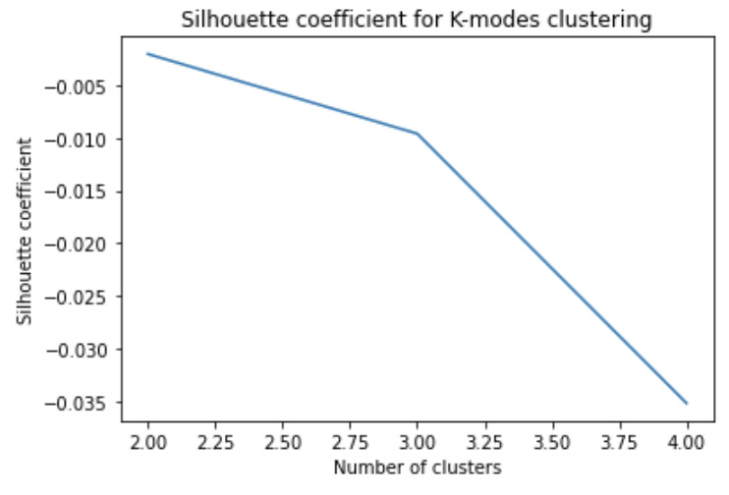
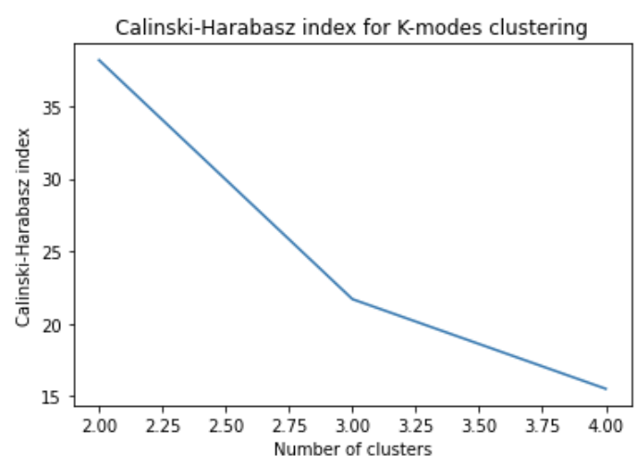
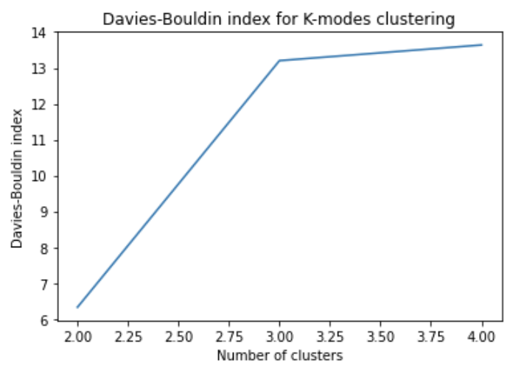
Validating the effectiveness of clusters
Silhouette coefficient
A measure of how well each data point is assigned to its cluster.
Calinski - Harabasz index
A measure of the separation between clusters.
Davies-Bouldin index
A measure of the compactness and separation of clusters.
A high value indicates that the data point is well-assigned to its cluster.
A high Calinski - Harabasz index indicates that the clusters are well-separated.
A low value indicates that the clusters are compact and well-separated.
-

Slide 28
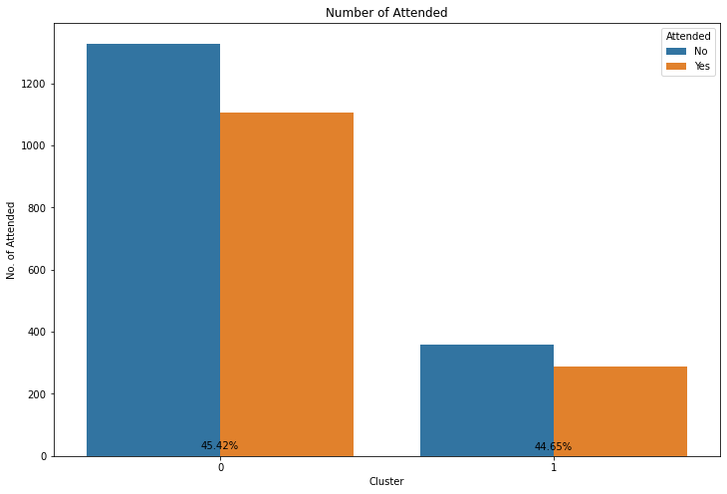
Attended Yes or No
Cluster | Yes Rate
0 | 45.42
1 | 44.55
Notes:
Source(3DHEALS logo): https://logovectordl.com/3dheals-llc-logo-vector-svg/
Source(background): https://www.fastradius.com/resources/video-lattice-design-and-foam-replacement-in-3d-printing/
Color: https://3dheals.com/
Source: https://www.analyticsvidhya.com/blog/2021/06/kmodes-clustering-algorithm-for-categorical-data/

Slide 29
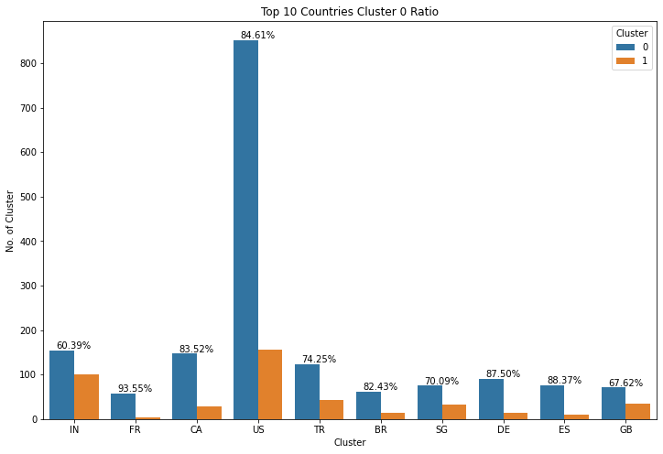
By Countries
Notes:
Source(3DHEALS logo): https://logovectordl.com/3dheals-llc-logo-vector-svg/
Source(background): https://www.fastradius.com/resources/video-lattice-design-and-foam-replacement-in-3d-printing/
Color: https://3dheals.com/
Source: https://www.analyticsvidhya.com/blog/2021/06/kmodes-clustering-algorithm-for-categorical-data/

Slide 30
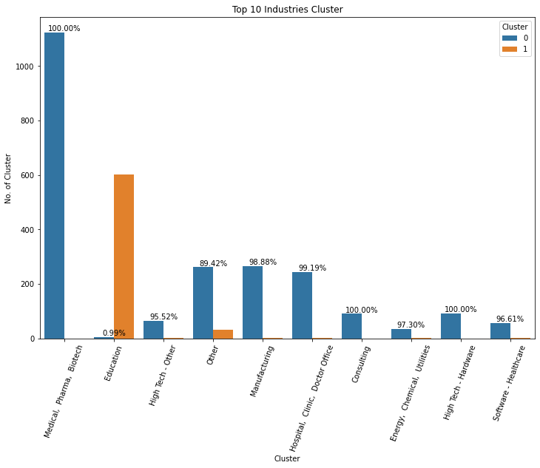
By Industries
Notes:
Source(3DHEALS logo): https://logovectordl.com/3dheals-llc-logo-vector-svg/
Source(background): https://www.fastradius.com/resources/video-lattice-design-and-foam-replacement-in-3d-printing/
Color: https://3dheals.com/
Source: https://www.analyticsvidhya.com/blog/2021/06/kmodes-clustering-algorithm-for-categorical-data/

Slide 31
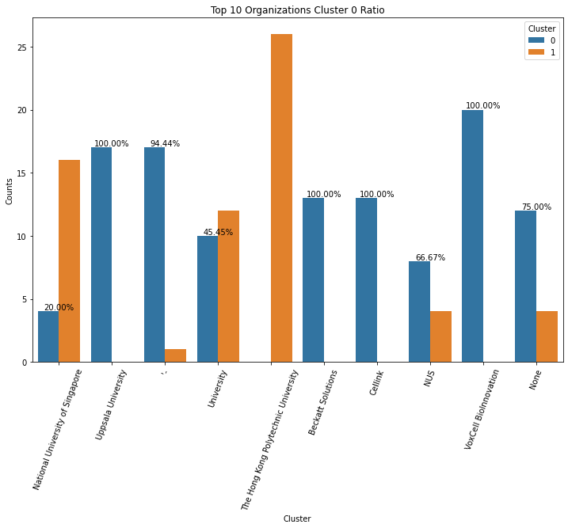
By Organizations
Notes:
Source(3DHEALS logo): https://logovectordl.com/3dheals-llc-logo-vector-svg/
Source(background): https://www.fastradius.com/resources/video-lattice-design-and-foam-replacement-in-3d-printing/
Color: https://3dheals.com/
Source: https://www.analyticsvidhya.com/blog/2021/06/kmodes-clustering-algorithm-for-categorical-data/

Slide 32
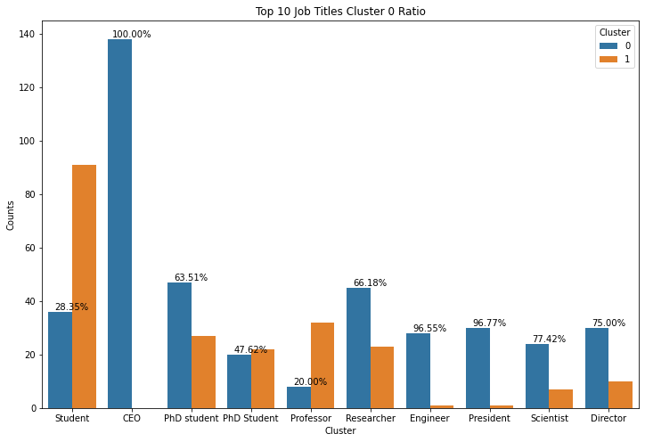
By Job Titles
Notes:
Source(3DHEALS logo): https://logovectordl.com/3dheals-llc-logo-vector-svg/
Source(background): https://www.fastradius.com/resources/video-lattice-design-and-foam-replacement-in-3d-printing/
Color: https://3dheals.com/
Source: https://www.analyticsvidhya.com/blog/2021/06/kmodes-clustering-algorithm-for-categorical-data/

Slide 33
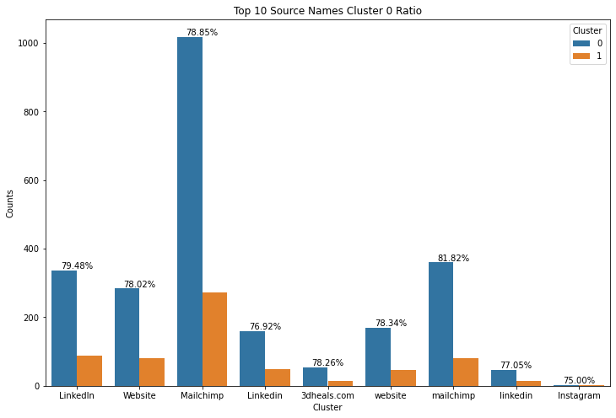
By Source Name
Notes:
Source(3DHEALS logo): https://logovectordl.com/3dheals-llc-logo-vector-svg/
Source(background): https://www.fastradius.com/resources/video-lattice-design-and-foam-replacement-in-3d-printing/
Color: https://3dheals.com/
Source: https://www.analyticsvidhya.com/blog/2021/06/kmodes-clustering-algorithm-for-categorical-data/

Slide 34
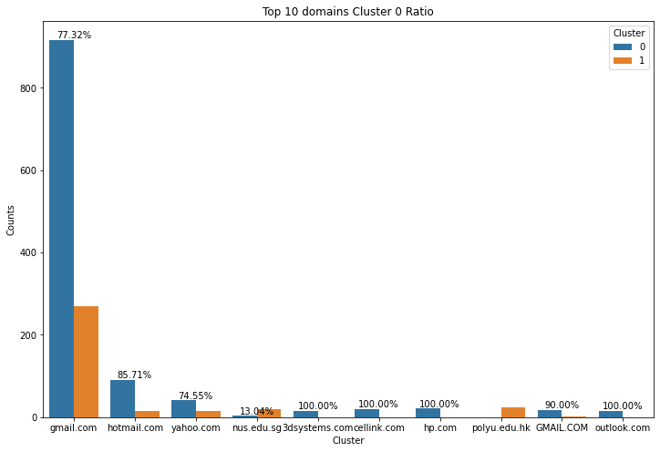
By Domain_name
Notes:
Source(3DHEALS logo): https://logovectordl.com/3dheals-llc-logo-vector-svg/
Source(background): https://www.fastradius.com/resources/video-lattice-design-and-foam-replacement-in-3d-printing/
Color: https://3dheals.com/
Source: https://www.analyticsvidhya.com/blog/2021/06/kmodes-clustering-algorithm-for-categorical-data/

Slide 35
Next
Steps
05
Future Plans
Notes:
Source(3DHEALS logo): https://logovectordl.com/3dheals-llc-logo-vector-svg/
Source(background): https://www.fastradius.com/resources/video-lattice-design-and-foam-replacement-in-3d-printing/
Color: https://3dheals.com/

Slide 36
Future Plans
Email Lookalike Generation
Performance Evaluation - A/B testing
Other clustering methods – K prototype clustering, Hierarchical clustering, DBSCAN
Explore additional features
Work on the topic - Predicting channel of preference of communication
Notes:
Source(3DHEALS logo): https://logovectordl.com/3dheals-llc-logo-vector-svg/
Source(background): https://www.fastradius.com/resources/video-lattice-design-and-foam-replacement-in-3d-printing/
Color: https://3dheals.com/

Slide 37
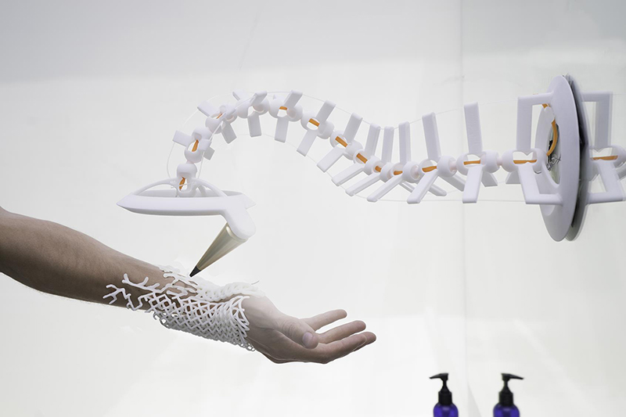
Q&A
Q&A
Thank you!
Notes:
Source: https://www.upgrade100.com/updates/the-boundaries-of-3d-printing-in-healthcare/
Source(3DHEALS logo): https://logovectordl.com/3dheals-llc-logo-vector-svg/
Color: https://3dheals.com/

Slide 38
REFERENCE
3DHEALS. (n.d.). About us. Retrieved from https://3dheals.com/about-us
Deloitte. (2020). 2020 global health care outlook: Laying a foundation for the future. Retrieved from https://www2.deloitte.com/us/en/pages/life-sciences-and-health-care/articles/global-health-care-sector-outlook.html
Machado, L. (2018, August 20). Artificial intelligence and 3D printing. Medium. https://medium.com/healthcare-3d-printing-stories/artificial-intelligence-and-3d-printing-94f45f3e45dd
PwC. (2019). What's next for the pharmaceuticals industry, amid digital disruption and rapid technological advances? Retrieved from https://www.pwc.com/gx/en/pharma-life-sciences/pdf/pwc-pharma-2020.pdf
Statista. (2021). 3D printing - Statistics & Facts. Retrieved from https://www.statista.com/topics/1174/3d-printing
3D Systems. (n.d.). Healthcare. Retrieved from https://www.3dsystems.com/healthcare
3DHEALS. (n.d.). About us. Retrieved from https://3dheals.com/about
Gartner. (2018). Gartner says 3D printing is changing the landscape of the medical device market. Retrieved from https://www.gartner.com/en/newsroom/press-releases/2018-04-03-gartner-says-3d-printing-is-changing-the-landscape-of-the-medical-device-market
Huang, S. H., Liu, P., Mokasdar, A., & Hou, L. (2020). Additive manufacturing and its societal impact: A literature review. The International Journal of Advanced Manufacturing Technology, 67(5-8), 1191-1203. doi: 10.1007/s00170-012-4558-5
Notes:
Source: https://noduslabs.com/cases/google-seo-strategies-text-mining/

Slide 39
REFERENCE
Organovo. (n.d.). About Organovo. Retrieved from https://organovo.com/about/Rengier, F., Mehndiratta, A., von Tengg-Kobligk, H., Zechmann, C. M., Unterhinninghofen, R.,Kauczor, H. U., & Giesel, F. L. (2010). 3D printing based on imaging data: Review of medical applications. International Journal of Computer Assisted Radiology and Surgery, 5(4), 335-341.doi: 10.1007/s11548-010-0476-x
Stratasys. (n.d.). Medical solutions. Retrieved from https://www.stratasys.com/medical
Suganya Karunamurthy. (2022). K-Mode Clustering | solved example | implementation. YouTube. Retrieved from https://www.youtube.com/watch?v=EVl2ejcsTfg
Harika Bonthu. (2021, June 13). KModes Clustering algorithm for categorical data. Analytics Vidhya. Retrieved from https://www.analyticsvidhya.com/blog/2021/06/kmodes-clustering-algorithm-for-categorical-data/#h-2-scree-plot-or-elbow-curve-to-find-optimal-kvalue
PRASHANT BANERJEE. (2022). K-Means clustering with Python. Kaggle. Retrieved from https://www.kaggle.com/code/prashant111/k-means-clustering-with-python
ASHISH. (2020). Bank customer clustering (K-Modes Clustering). Kaggle. Retrieved from https://www.kaggle.com/code/ashydv/bank-customer-clustering-k-modes-clustering/notebook
Notes:
Source: https://noduslabs.com/cases/google-seo-strategies-text-mining/

Slide 40
APPENDIX
EDA
03-1
Exploratory Data Analysis
Notes:
Source(3DHEALS logo): https://logovectordl.com/3dheals-llc-logo-vector-svg/
Source(background): https://www.fastradius.com/resources/video-lattice-design-and-foam-replacement-in-3d-printing/
Color: https://3dheals.com/

Slide 41
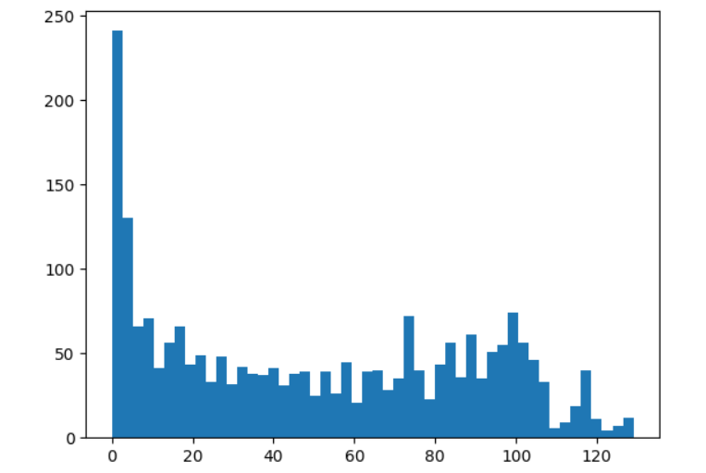
Time in Session (minutes)
Count: 2229.0
Mean: 50.4
Std: 37.9
Min: 0.0
25%: 13.0
50%: 47.0
75%: 85.0
Max: 129.0
APPENDIX
Notes:
Source(3DHEALS logo): https://logovectordl.com/3dheals-llc-logo-vector-svg/
Source(background): https://www.fastradius.com/resources/video-lattice-design-and-foam-replacement-in-3d-printing/
Color: https://3dheals.com/

Slide 42
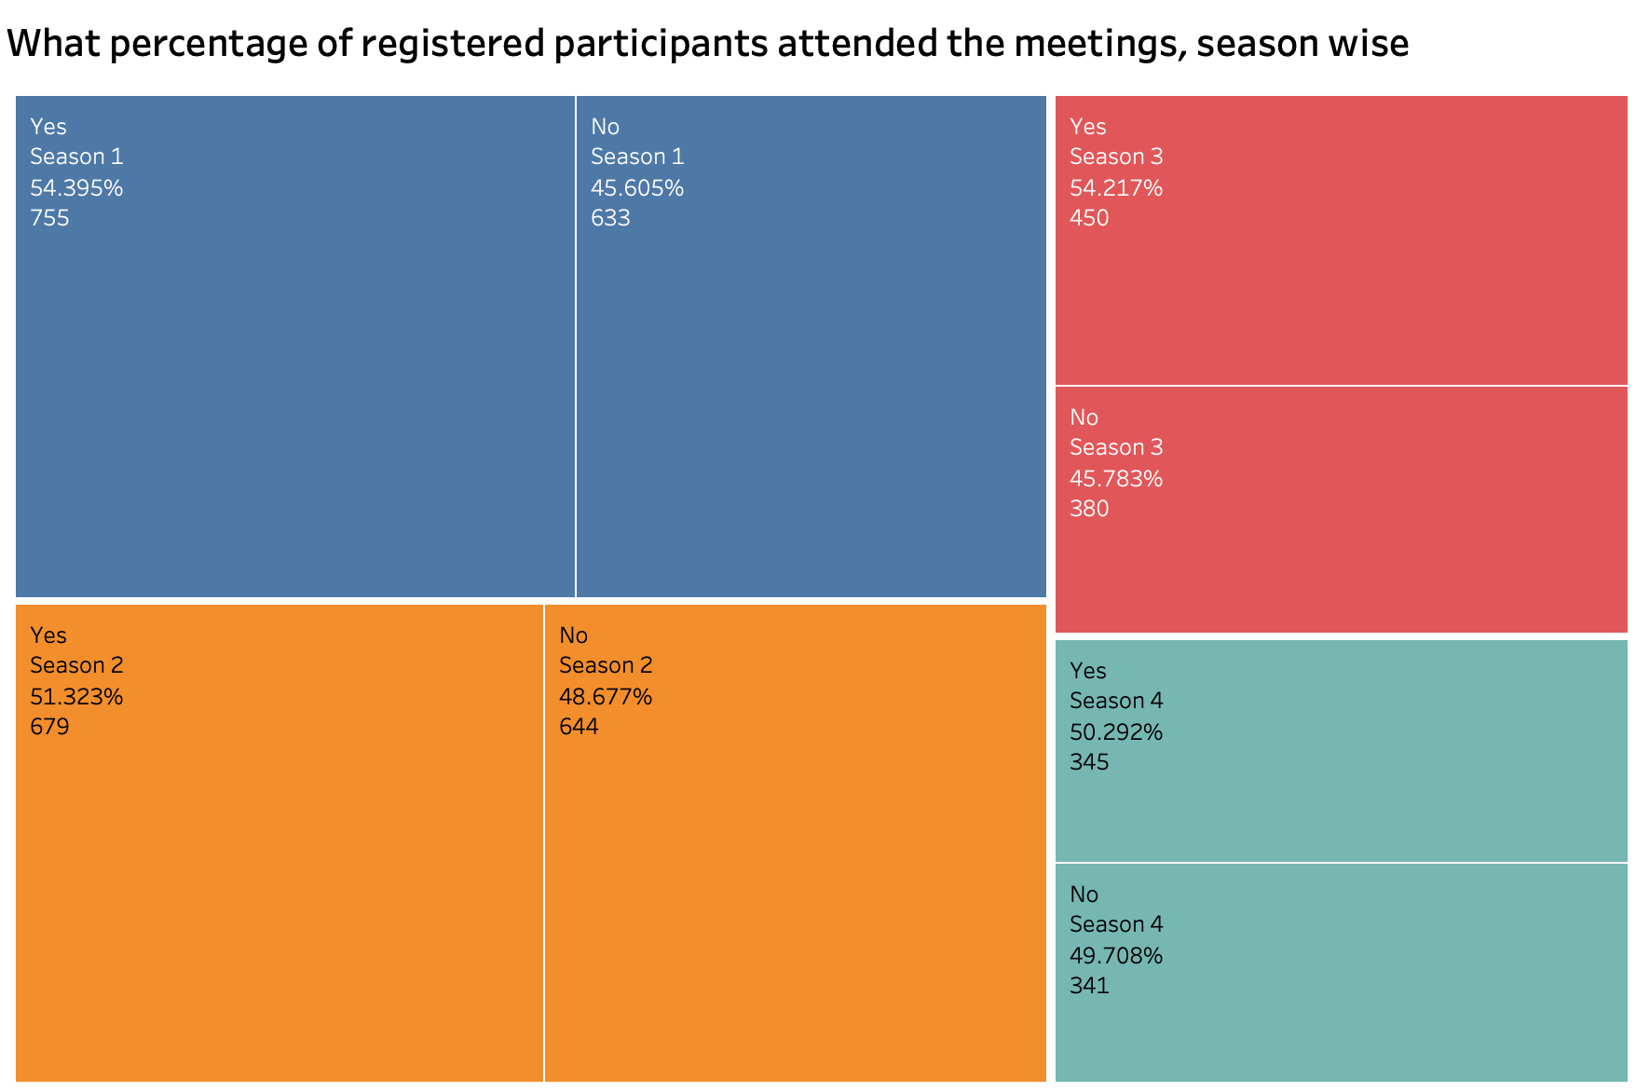
Season wise, Attended
APPENDIX
Notes:
Source(3DHEALS logo): https://logovectordl.com/3dheals-llc-logo-vector-svg/
Source(background): https://www.fastradius.com/resources/video-lattice-design-and-foam-replacement-in-3d-printing/
Color: https://3dheals.com/

Slide 43
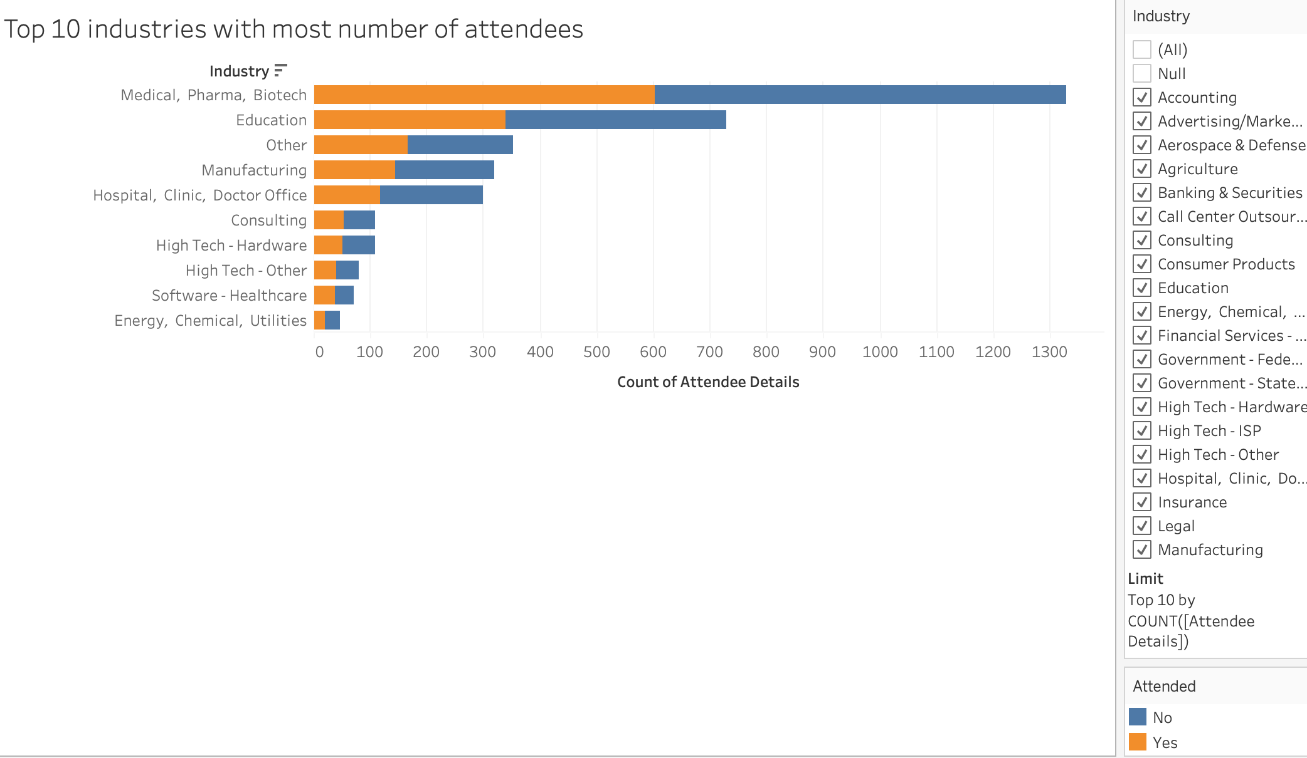
Top 10 industries with most attendees
APPENDIX
Notes:
Source(3DHEALS logo): https://logovectordl.com/3dheals-llc-logo-vector-svg/
Source(background): https://www.fastradius.com/resources/video-lattice-design-and-foam-replacement-in-3d-printing/
Color: https://3dheals.com/

Slide 44
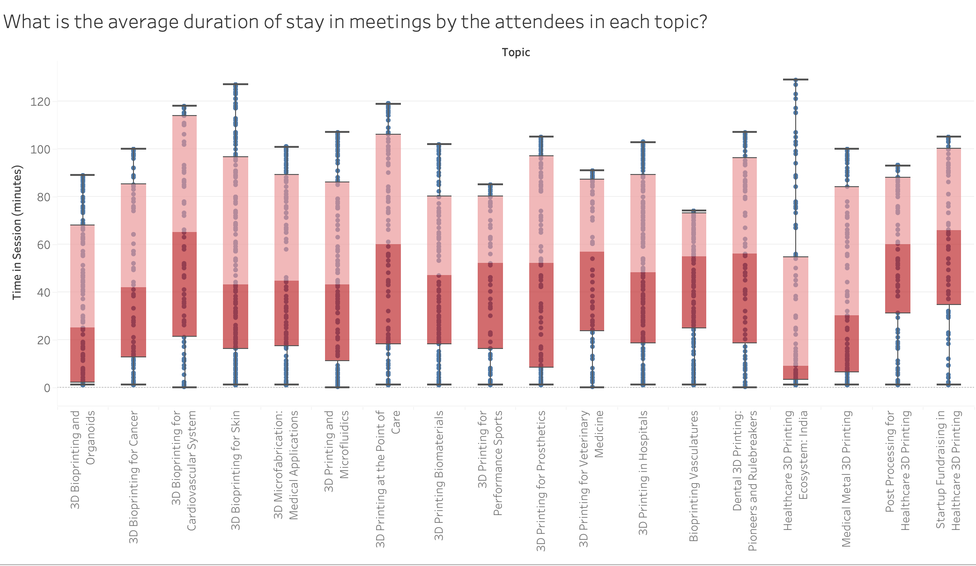
Average Duration
APPENDIX
Notes:
Source(3DHEALS logo): https://logovectordl.com/3dheals-llc-logo-vector-svg/
Source(background): https://www.fastradius.com/resources/video-lattice-design-and-foam-replacement-in-3d-printing/
Color: https://3dheals.com/

Slide 45
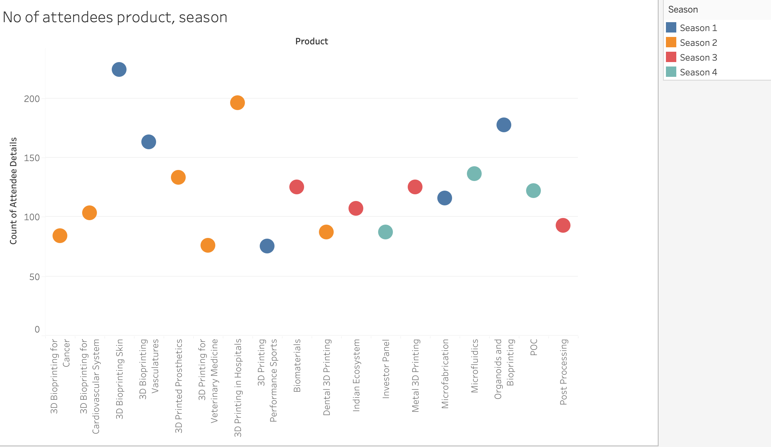
Num of Attendees by product & Season
APPENDIX
Notes:
Source(3DHEALS logo): https://logovectordl.com/3dheals-llc-logo-vector-svg/
Source(background): https://www.fastradius.com/resources/video-lattice-design-and-foam-replacement-in-3d-printing/
Color: https://3dheals.com/

Slide 46
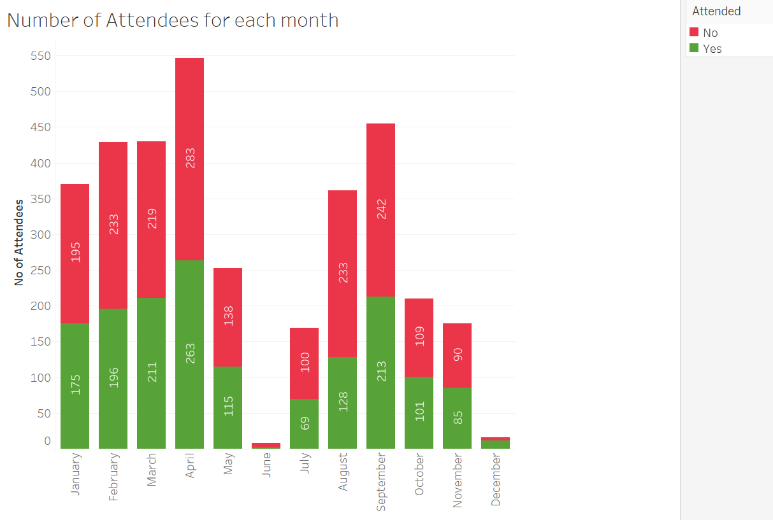
Attendees for each month
APPENDIX
Notes:
Source(3DHEALS logo): https://logovectordl.com/3dheals-llc-logo-vector-svg/
Source(background): https://www.fastradius.com/resources/video-lattice-design-and-foam-replacement-in-3d-printing/
Color: https://3dheals.com/

Slide 47
Wordcloud of Top 20 Attendee’s Job title
APPENDIX
Notes:
Source(3DHEALS logo): https://logovectordl.com/3dheals-llc-logo-vector-svg/
Source(background): https://www.fastradius.com/resources/video-lattice-design-and-foam-replacement-in-3d-printing/
Color: https://3dheals.com/

Slide 48
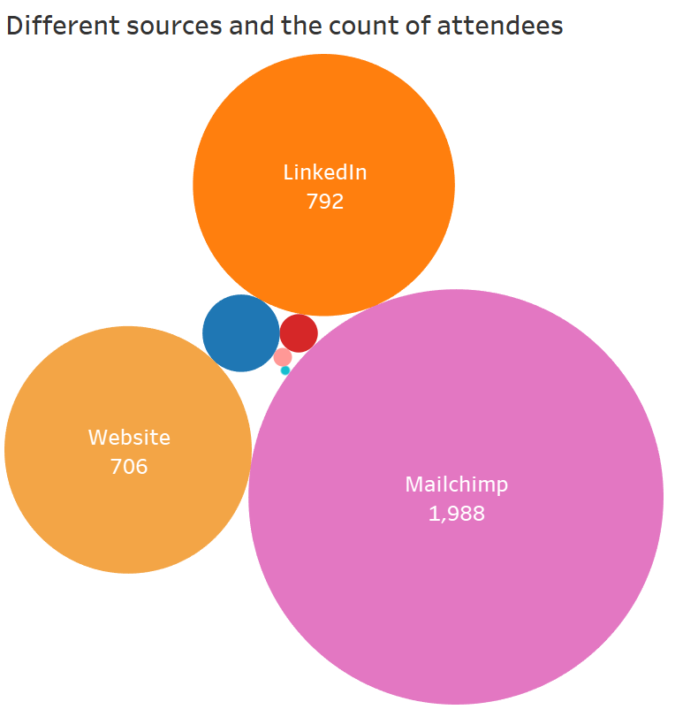
Count of attendess by different source
APPENDIX
Notes:
Source(3DHEALS logo): https://logovectordl.com/3dheals-llc-logo-vector-svg/
Source(background): https://www.fastradius.com/resources/video-lattice-design-and-foam-replacement-in-3d-printing/
Color: https://3dheals.com/

Slide 49
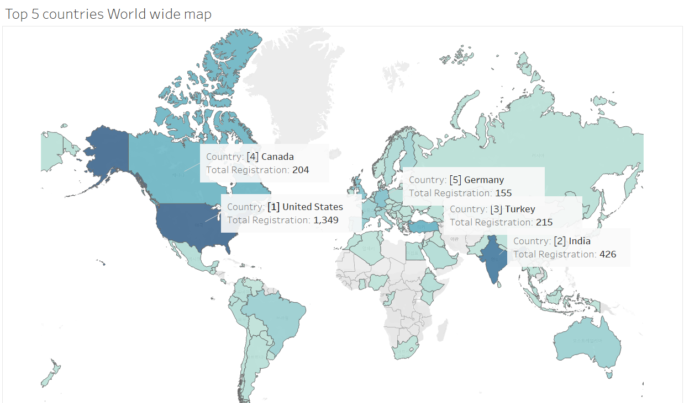
Top 5 Countries by Registration
APPENDIX
Notes:
Source(3DHEALS logo): https://logovectordl.com/3dheals-llc-logo-vector-svg/
Source(background): https://www.fastradius.com/resources/video-lattice-design-and-foam-replacement-in-3d-printing/
Color: https://3dheals.com/

Slide 50
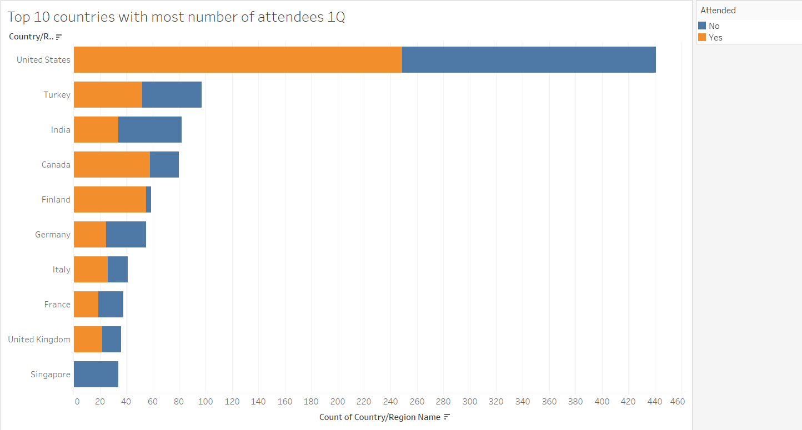
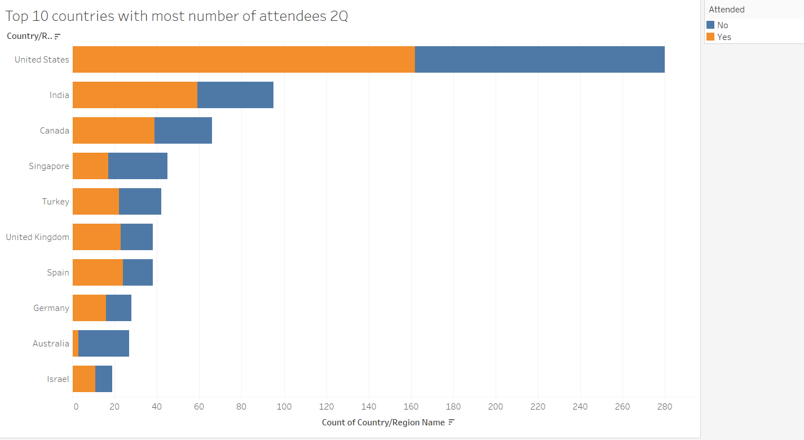
APPENDIX
Notes:
Source(3DHEALS logo): https://logovectordl.com/3dheals-llc-logo-vector-svg/
Source(background): https://www.fastradius.com/resources/video-lattice-design-and-foam-replacement-in-3d-printing/
Color: https://3dheals.com/

Slide 51
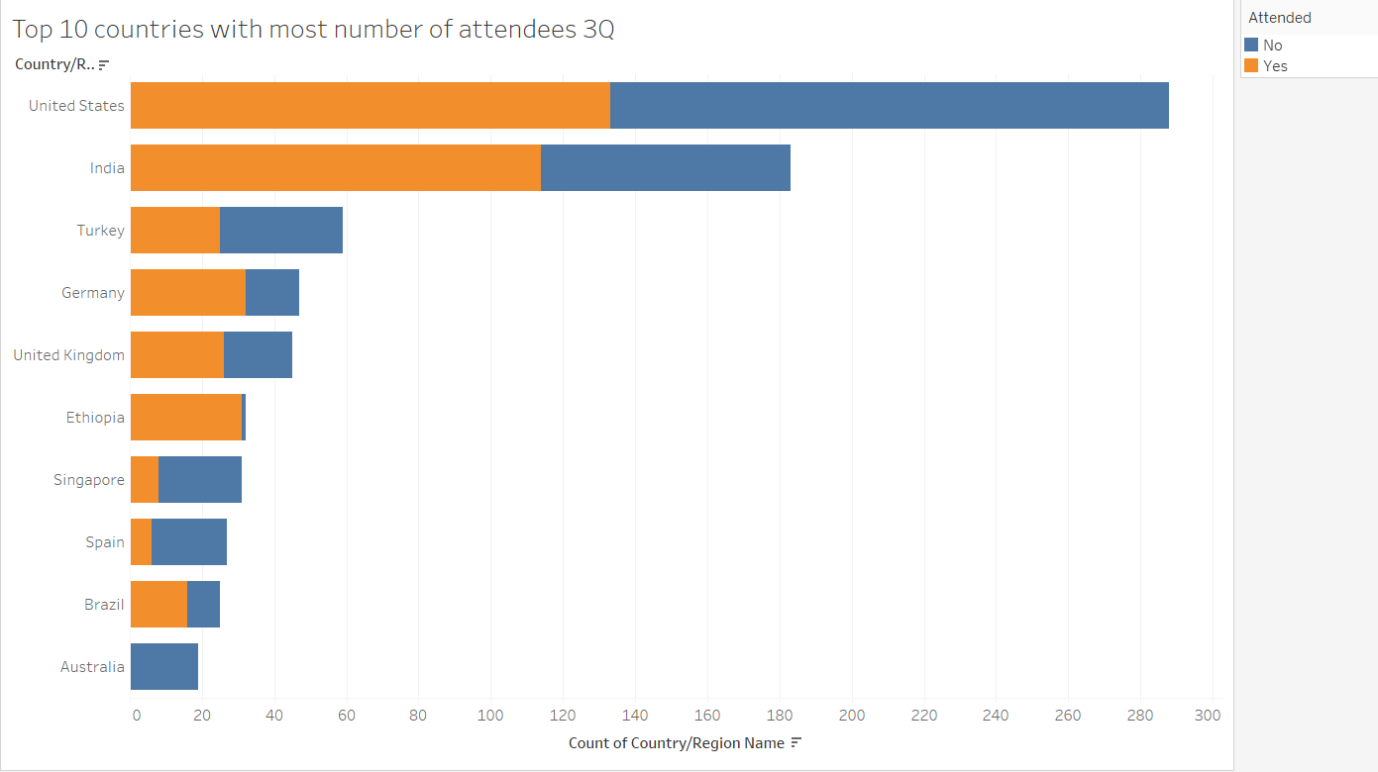
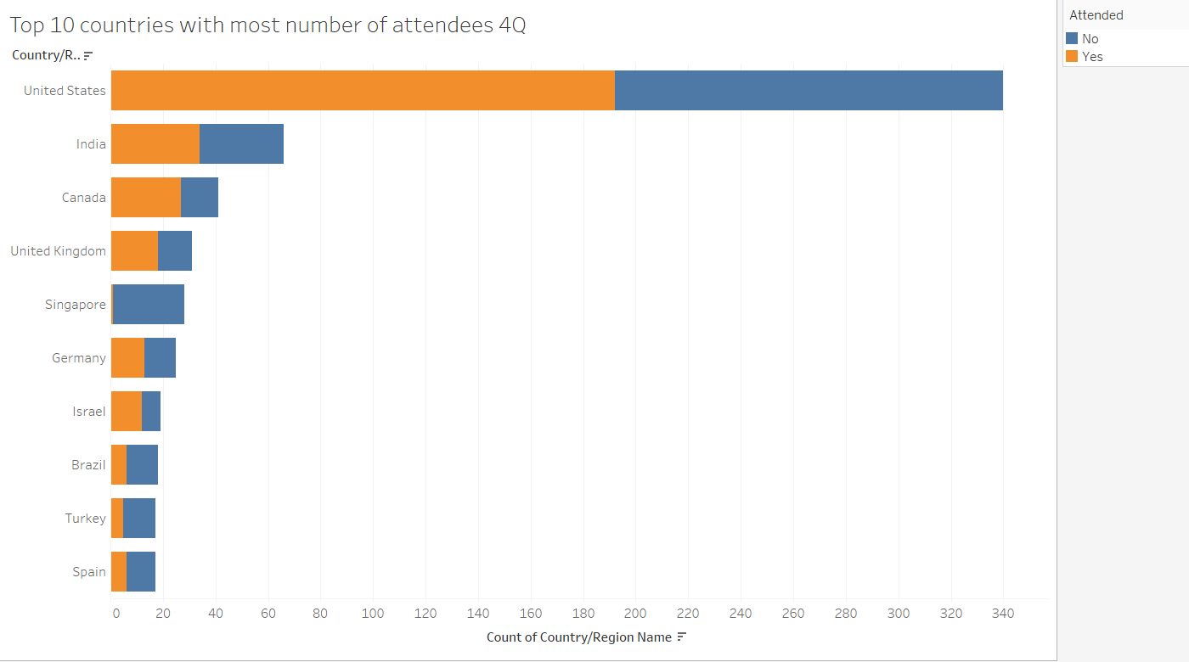
APPENDIX
Notes:
Source(3DHEALS logo): https://logovectordl.com/3dheals-llc-logo-vector-svg/
Source(background): https://www.fastradius.com/resources/video-lattice-design-and-foam-replacement-in-3d-printing/
Color: https://3dheals.com/

Slide 52
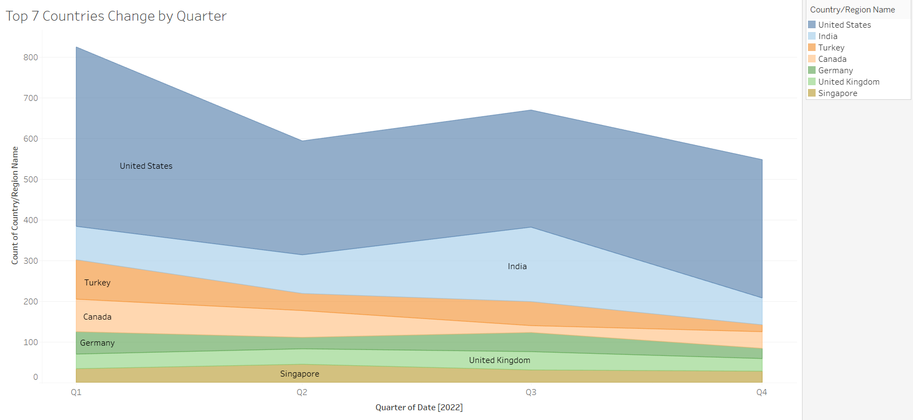
Top 7 Countries by quarter
APPENDIX
Notes:
Source(3DHEALS logo): https://logovectordl.com/3dheals-llc-logo-vector-svg/
Source(background): https://www.fastradius.com/resources/video-lattice-design-and-foam-replacement-in-3d-printing/
Color: https://3dheals.com/

Slide 53
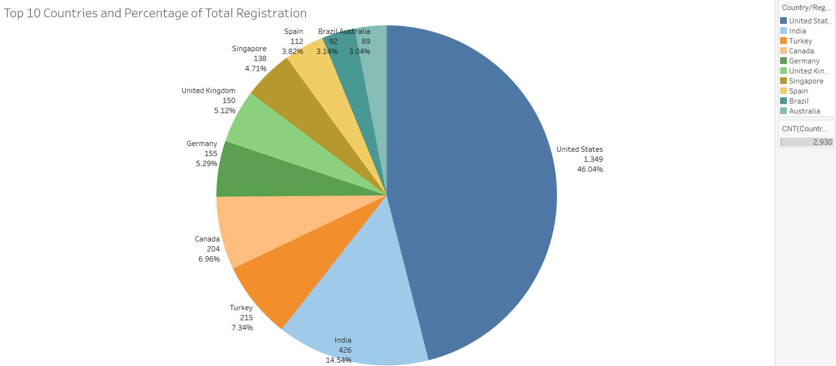
Pie Chart of Top 10 Countries
APPENDIX
Notes:
Source(3DHEALS logo): https://logovectordl.com/3dheals-llc-logo-vector-svg/
Source(background): https://www.fastradius.com/resources/video-lattice-design-and-foam-replacement-in-3d-printing/
Color: https://3dheals.com/

Slide 54
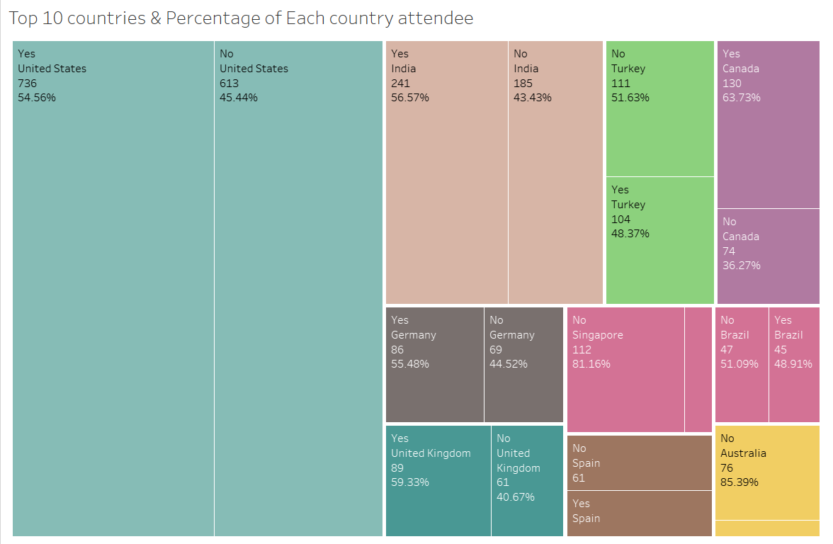
Top 10 countries & percentage of attendee
APPENDIX
Notes:
Source(3DHEALS logo): https://logovectordl.com/3dheals-llc-logo-vector-svg/
Source(background): https://www.fastradius.com/resources/video-lattice-design-and-foam-replacement-in-3d-printing/
Color: https://3dheals.com/

Slide 55
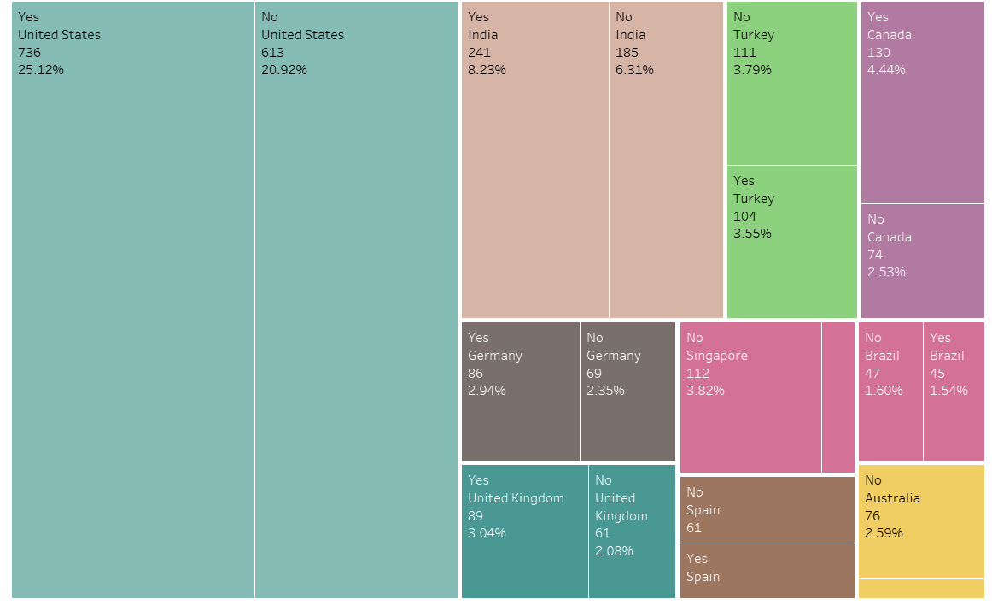
Top 10 countries & percentage of Total attendee
APPENDIX
Notes:
Source(3DHEALS logo): https://logovectordl.com/3dheals-llc-logo-vector-svg/
Source(background): https://www.fastradius.com/resources/video-lattice-design-and-foam-replacement-in-3d-printing/
Color: https://3dheals.com/

